Slide 1


Caribbean Studies CAS101

Slide 2

Student Guidelines:
Email: mjames@tamcc.edu.gd
WhatsApp Groups
Groups can be used for discussion & sharing censored information
Students unable to attend class should message via WhatsApp
Course Evaluation: 40% coursework 60% final exam
Moodle sign-up
Please ensure to sign-up in your correct group
All lecture slides, assignments, and grades will be posted on Moodle.
Attendance can be monitored on Moodle
Assignments
Assignments are due on the specified date provided.
Upload assignments to Moodle for grading
A penalty of 1mk per day for submissions after due date.
After 3 days no late submissions will be accepted.
Assignments that have been plagiarized will received a 0 grade

Slide 3

Students are encouraged to compile a Glossary of key terms and concepts learnt in each Module.
Students will deliver presentation on the impact of societal & political institutions on the Caribbean society, culture, & people.

Slide 4
About Caribbean Studies
Caribbean is defined in terms of the following features:
Geography
Shared historical experiences
Cultural Identities
Participation in the Global community
Intermixing of ethnics and racial groups
Continued struggle for survival and sovereignty.
Description
An interdisciplinary study that draws on perspectives, primarily humanities & social sciences, to provide insight & understanding of Caribbean society and cultures.
Studies issues relating to the Caribbean and the physical, political and socio-economic challenges.
On completion, students, will have:
Greater understanding & appreciation of the development of the Caribbean and its challenges
Understanding of their role in preserving and contribution to their heritage
Appreciate the importance of regional cooperation for the development of the Caribbean.

Slide 5
Objectives & Modules
Students will:
Study the effects of the physical, political and socio-economic factors on regions.
Review the aspects Culture, History, Ethics, Economics, Physical and Human Ecology to understand the Caribbean society and culture.
Decipher their role in preserving & contributing to their Caribbean heritage
Explore the significance of regional cooperation in the development of the Caribbean
Module 1: Geography & Culture
Module 2: Society & Culture
Module 3: The Caribbean & the Wider World
Module 4: Exploring Concept & Development

Slide 6
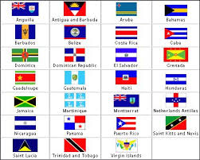
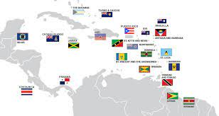
Caribbean Nations

